Slide 1

Introduction of S-protector
Wecan Medicare

Slide 2
Content
1. Introduction of S-protector
2. Patent/Approvals
3. Marketing activities

Slide 3
Content
1. Introduction of S-protector
2. Patent/Approvals
3. Marketing activities

Slide 4
Introduction of S-protector
We found unmet needs in the surgical wound protection for thyroid surgery and developed
S-protector

Slide 5
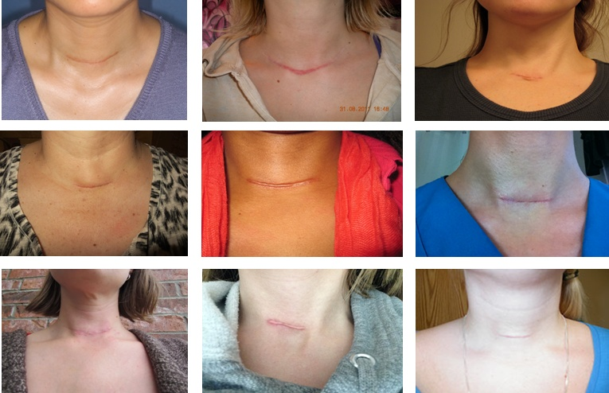
Introduction of S-protector
Thyroidectomy leaves various scars on the neck and 78.8% of patients were female in Korea (National Surgical Statistics in 2014)

Slide 6
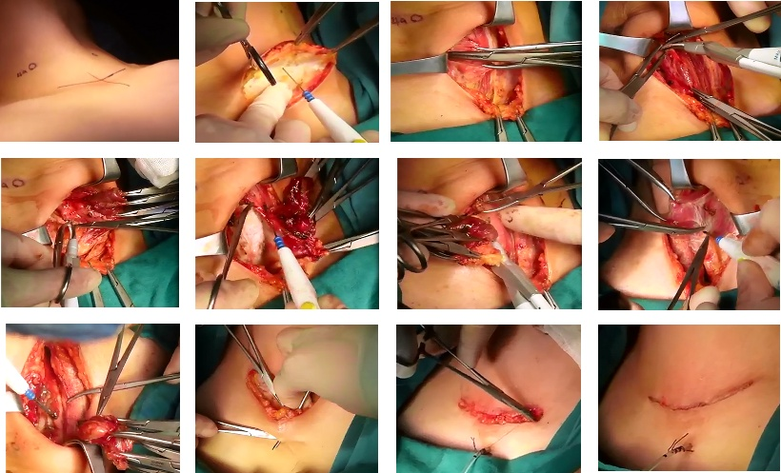
Introduction of S-protector
Metal retractors that are currently used in thyroid surgery cause ischemic tissue damage and scarring as a result of uneven pressure distribution
Energy devices are now widely used and can cause stray burns
Tissue damage

Slide 7
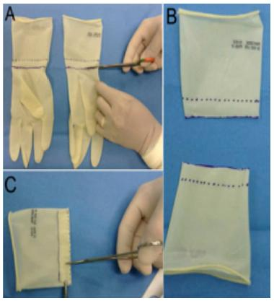
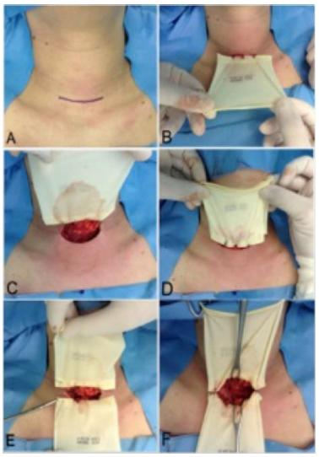
Introduction of S-protector
Most surgeons make homemade gadgets to protect the skin
Inefficient
Inconvenient
Need a preparation time

Slide 8
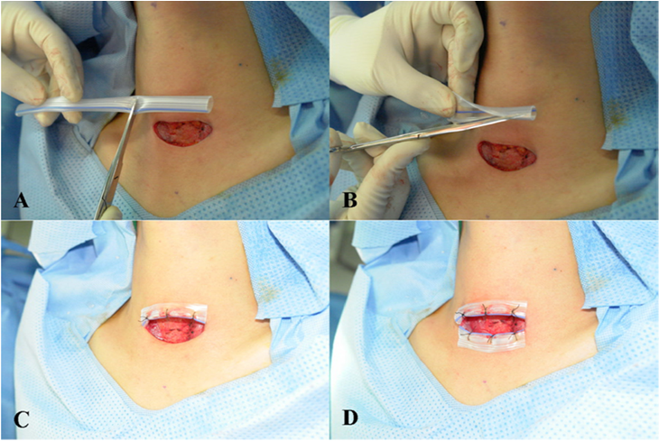
Introduction of S-protector
A pen rose drain is used to protect the incised skin edges during Thyroidectomy
temporarily sutured
‘Use of a Silicone Penrose Drain to Protect Incised Skin Edges During Thyroid Surgery’
(Hang-Seok Chang, Thyroid Cancer Center, Gangnam Severance Hospital, Yonsei University College)

Slide 9
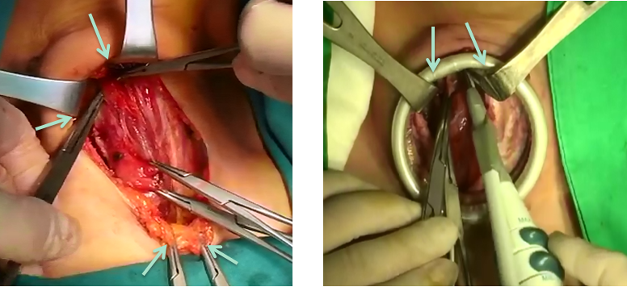
Introduction of S-protector
Surgical Wound Protector can alleviate the localized tension and prevent stray burns.
Without Protector
With Protector
But, a ring plastic protector is hardly used because it disturbs
the operation due to the thick ring
(several devices are used in the small space)

Slide 10
Introduction of S-protector
Objectives of development
How to distribute localized force evenly
How to improve Alexis(ring wound protectors)
What is a safer material than plastic?
(to avoid chemical exposure to blood vessel)
Can the protector be meaningful in ergonomics?
(save the preparation time and reduce the number of surgical assistants)
Through several modifications, a new design was
developed and we named it ‘S-protector’ meaning
a new smart protector

Slide 11
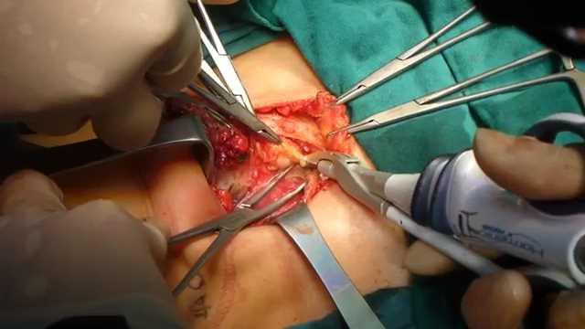
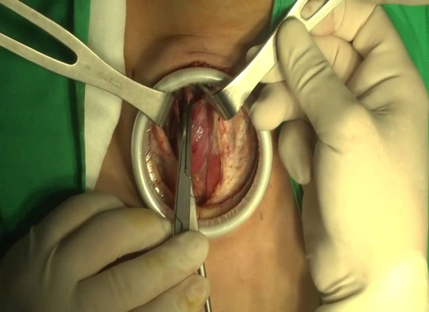
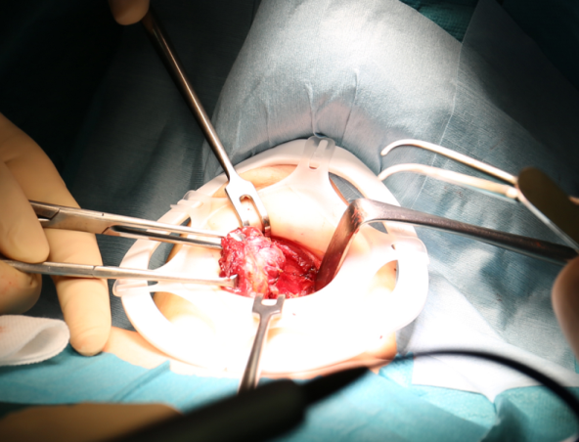

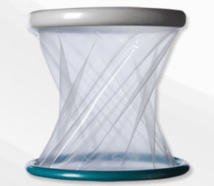
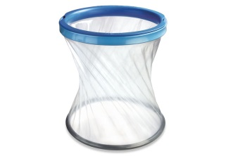
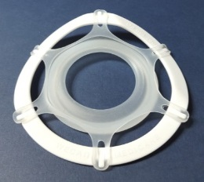
Introduction of S-protector
Development
No protector
Ring plastic protector
Smart protector
Home made gadget
Alexis
Applied Medical
(USA)
Surgisleeve
Medtronic
(USA)
S-protector
Wecan Medicare
(Korea)

Slide 12

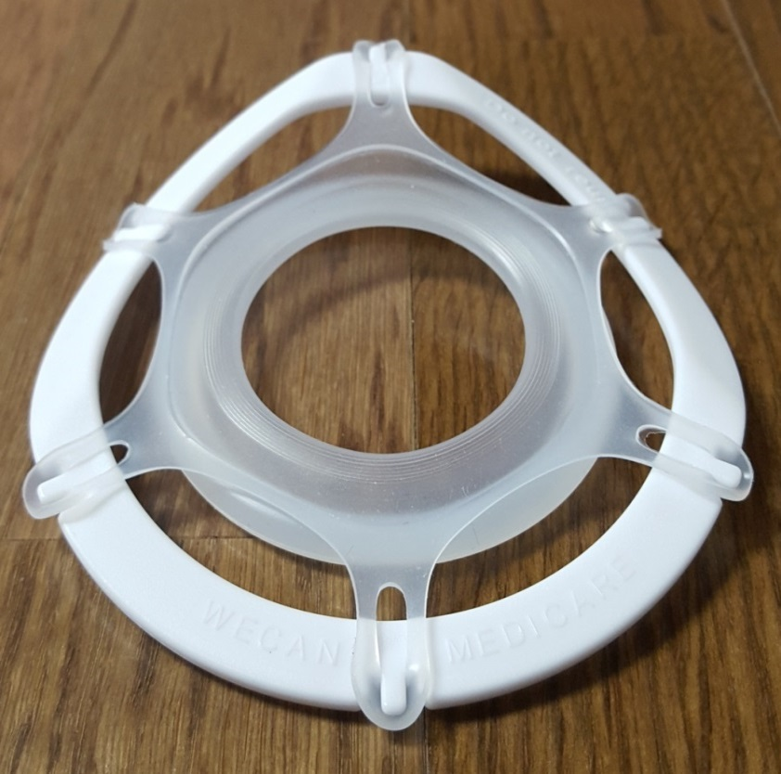
S-protector
(Surgical wound protector for thyroidectomy)
Head side
Curved shape to fit to the neck
Code | Incision size
XX-small* | 1 ~ 2 cm
X-small | 2 ~ 3 cm
Small | 3 ~ 5 cm
Medium | 5 ~ 7 cm
Large* | 7 ~ 10 cm
Protector
(Material: Silicon)
Protect the skin edge and retract
the surgical cavity
Frame
(Material: Polypropylene)
*XX-small size will be commercialized
in April 2018

Slide 13
Why S-protector is better than competing products?

Slide 14
Introduction of S-protector
Competing product list
Establishment name | Country | Product | No. of approvals
Applied Medical Australia | Australia | Ring(Wound Protector), Drape Retention, Internal | 3
Applied Medical Distribution Center | USA | Ring(Wound Protector), Drape Retention, Internal | 14
Applied Medical Europe | Netherlands | Ring(Wound Protector), Drape Retention, Internal | 4
Applied Medical Resources Corp. | USA | Ring(Wound Protector), Drape Retention, Internal | 5
Applied Medical Resources Corporation | USA | Ring(Wound Protector), Drape Retention, Internal | 4
Changzhou Ankang Medical Instruments Co. | China | Disposable Wound Protector(4 items) | 1
Covidien | USA | SurgiSleeve TM Wound Protector, Drape, Surgical SurgiSleeve TM Extra Small Wound Protector | 6
Covidien LLC | USA | SurgiSleeve TM Wound Protector - Laparoscope, General & Plastic Surgery | 4
Isomedix Operations, Inc | Canada | Ring(Wound Protector), Drape Retention, Internal | 1
Jiangsu JDC Medical Devices Co. Ltd | China | Wound Protector, Ring(Wound Protector), Drape Retention, Internal | 1
43 products were approved by FDA(Regulation No.: 878.4370)

Slide 15
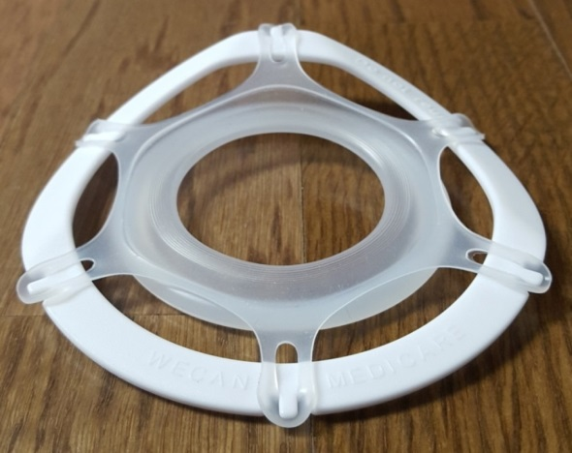
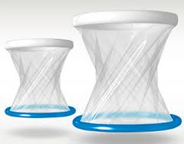
Introduction of S-protector
Competing products
(Ring plastic protectors)
S-protector
Brand: Alexis
Applied Medical, USA
The 1st developer and market leader
Improved
Brand: SurgiSleeve
Covidien/Medtronic
The 2nd market leader with modified products
Brand: S-protector
Wecan Medicare, Korea
The innovator
Similar products
(Canada, China, e.t.c.)
- Patent granted
- PCT submitted

Slide 16
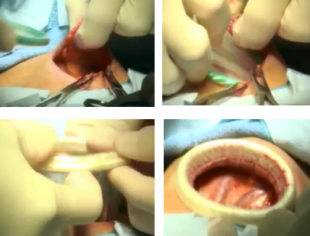
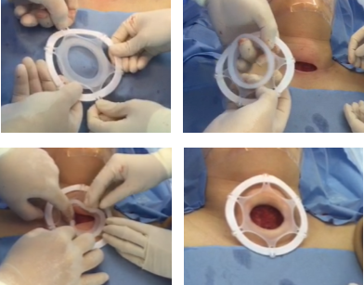
Introduction of S-protector
Improvement-1
Safer setup and removal
Ring wound protector
When inserted/removed, the skin is pulled and rigid ring causes a damage on the skin edge of incision [Setup] 1) Insert the green distal ring into the incision 2) Grasp the white proximal ring and roll it in/out until the incision is retracted
S-protector
A silicon ring is smoothly inserted and removed without touching the incision [Setup] : Faster and easier 1) Combine the flexible silicon protector with the white plastic frame 2) Flip the inside ring out and push it into incision
Restoring force
Elastic

Slide 17
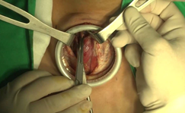

Introduction of S-protector
Improvement-2
More efficient surgery
Thick plastic ring
Inflexible and limited space
Thin plastic frame
Flexible and expandable space
The thick and rigid ring disturbs the use of surgical devices
The surgical space is not extended even by retractors
The thin plastic frame does not disturb the use of surgical devices
The surgical space can be flexibly extended by retractors

Slide 18
Introduction of S-protector
Efficacy of S-protector
Prevents stray burns
Prevents stray energy burns caused by energy device
Reduces the localized tension on the skin
Protects the skin edge and reduces localized tension caused by
metal retractors
Provides flexible space
Retracts skin gently and provides flexible(round or oval) space for
more efficient surgery
Improves surgical results
Reduces the pain after surgery, results in less scarring
Staves off the contamination of microbial or tumor cell

Slide 19


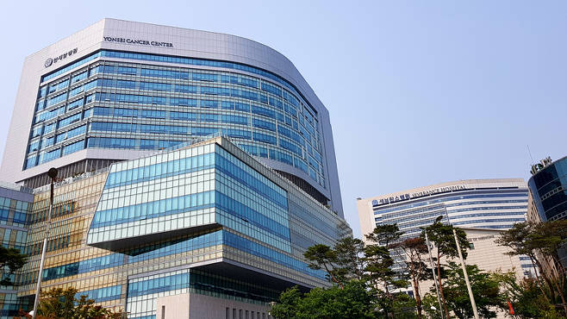
Introduction of S-protector
Usability Test in Korea
20 Endocrine surgeons in 17 major hospitals evaluated the usability(June, 2016);
100% said ‘better than ring plastic protectors’
100% said ‘efficient to reduce surgical scarring’
75% said ‘saves the operation time’
75% said ‘reduces the pain after surgery’
70% said ‘helps reduce surgical assistants’

Slide 20
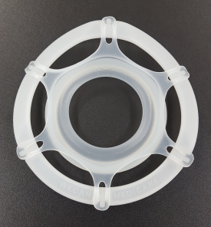
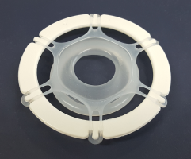
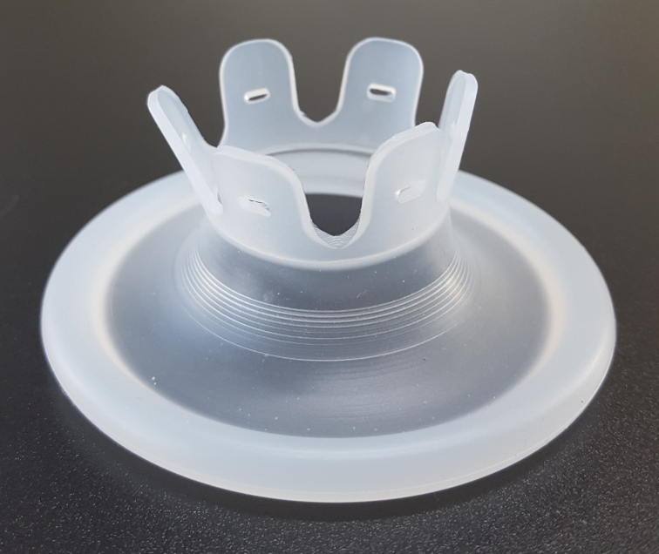
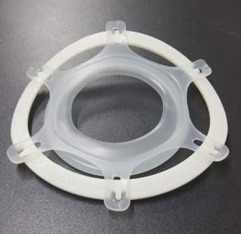
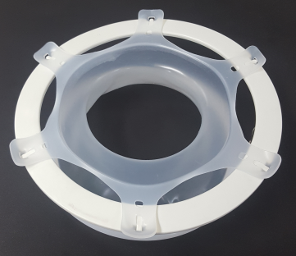
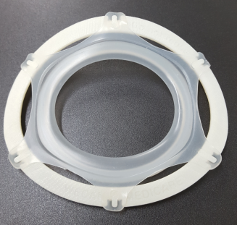
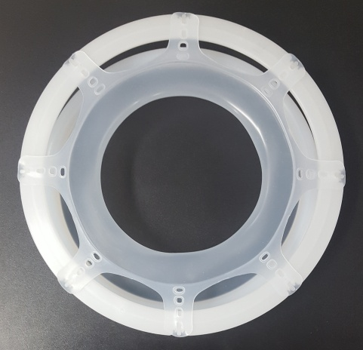
Introduction of S-protector
Product diversification
Core value is the design of protector by utilizing the property of silicon
Elastic
holder
Supporting ring
Different sizes of ring, height, length, width of holder,
hardness of silicon itself can make various shapes

Slide 21
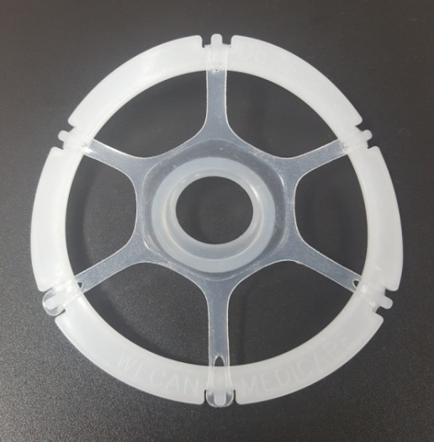
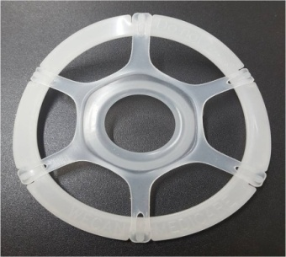
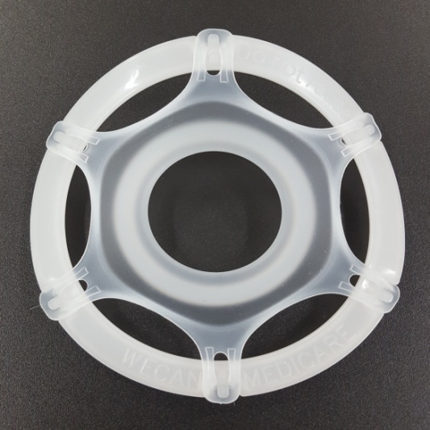
S-Protector for thyroid surgery
SP-T01C
Code | XXS
Incision | 1~2 cm
SP-T01B
Code | XS
Incision | 2~3 cm
SP-T01A
Code | S
Incision | 3~5 cm

Slide 22
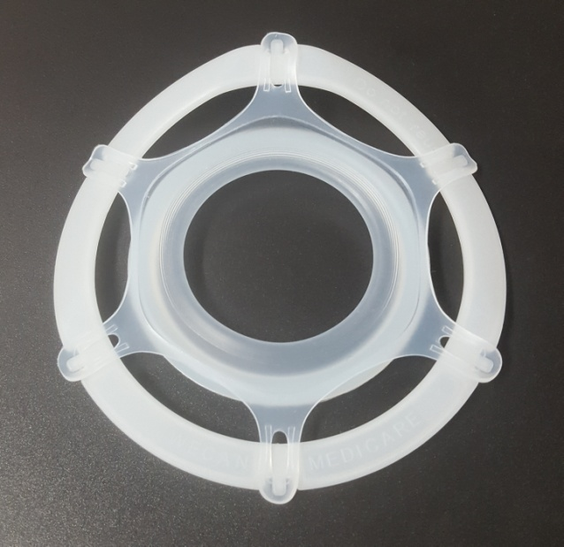
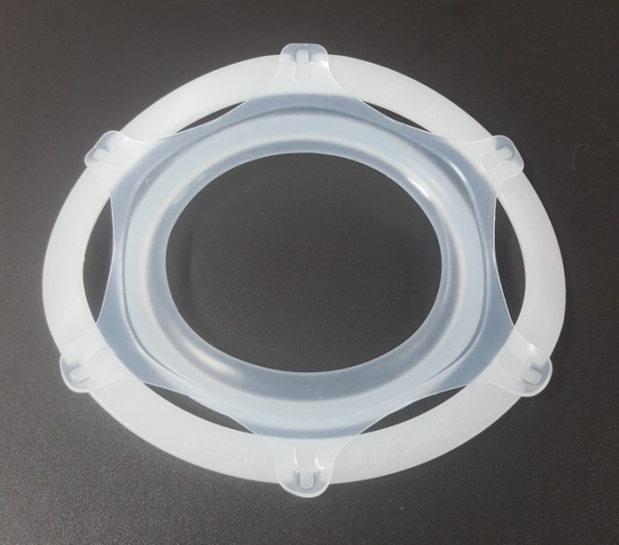
SP-T01
Code | M
Incision | 5~7 cm
SP-T02
Code | L
Incision | 7~10 cm

Slide 23
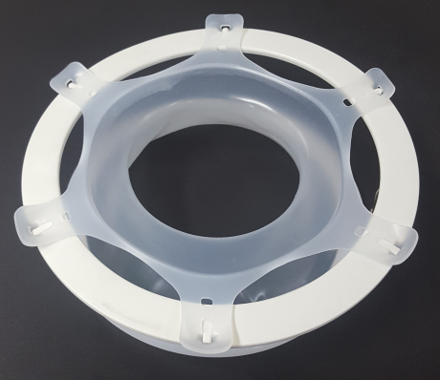
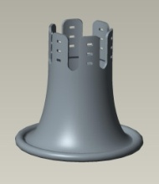
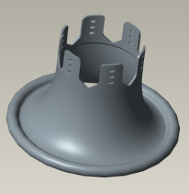
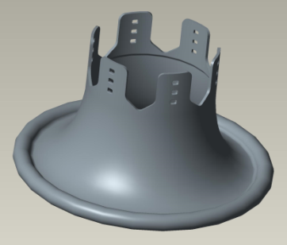
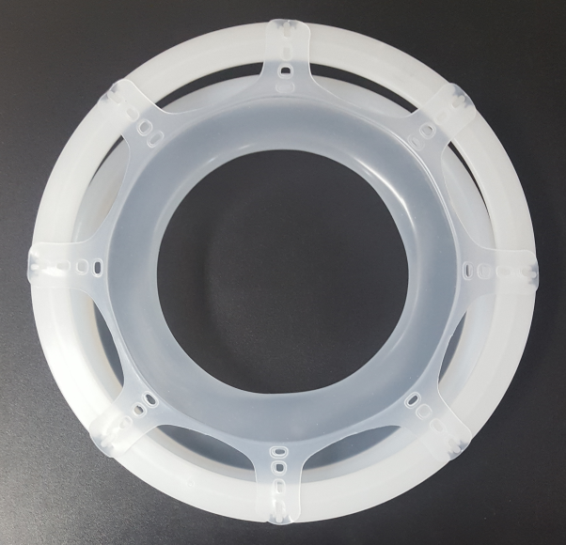
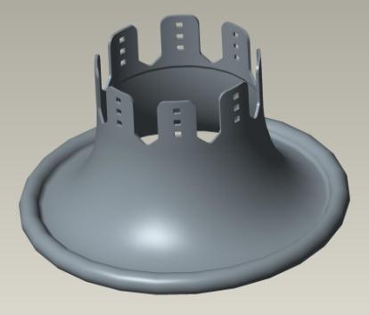
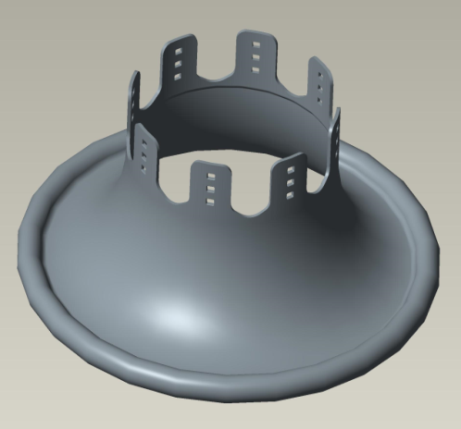
Introduction of S-protector
S-protector for general surgery
Silicon-B
Silicon-C1
Silicon-D1
Silicon-E1
Silicon-F1

Slide 24
Introduction of S-protector
S-protector for Thyroid surgery
Product code | Recommended incision size |  | Development | Approvals
SP-T01C | 1 ~ 2 cm | XXS | To be launched | CE, FDA
SP-T01B | 2 ~ 3 cm | XS | Launched | CE, FDA
SP-T01A | 3 ~ 5 cm | S | Launched | CE, FDA
SP-T01 | 5 ~ 7 cm | M | Launched | CE, FDA
SP-T02 | 7 ~ 10 cm | L | Launched | CE, FDA
S-protector for General surgery
Product code | Recommended incision size |  | Development | Approvals
SP-G01C | 1 ~ 2 cm | XXS | Usability testing | CE, FDA
SP-G01B | 2 ~ 3 cm | XS | Usability testing | CE, FDA
SP-G01A | 3 ~ 5 cm | S | Usability testing | CE, FDA
SP-G01 | 5 ~ 7 cm | M | Usability testing | CE, FDA
SP-G02 | 7 ~ 9 cm | L | Usability testing | CE, FDA
SP-G03 | 9 ~ 11 cm | XL | Usability testing | CE, FDA
SP-G04 | 11 ~ 13 cm | XXL | Usability testing | CE, FDA
SP-G05 | 13 ~ 15 cm | XXXL | Usability testing | CE, FDA

Slide 25
Content
1. Introduction of S-protector
2. Patent/Approvals
3. Marketing activities

Slide 26
The design of S-protector can be easily imitated
so the intellectual protection should be critical

Slide 27
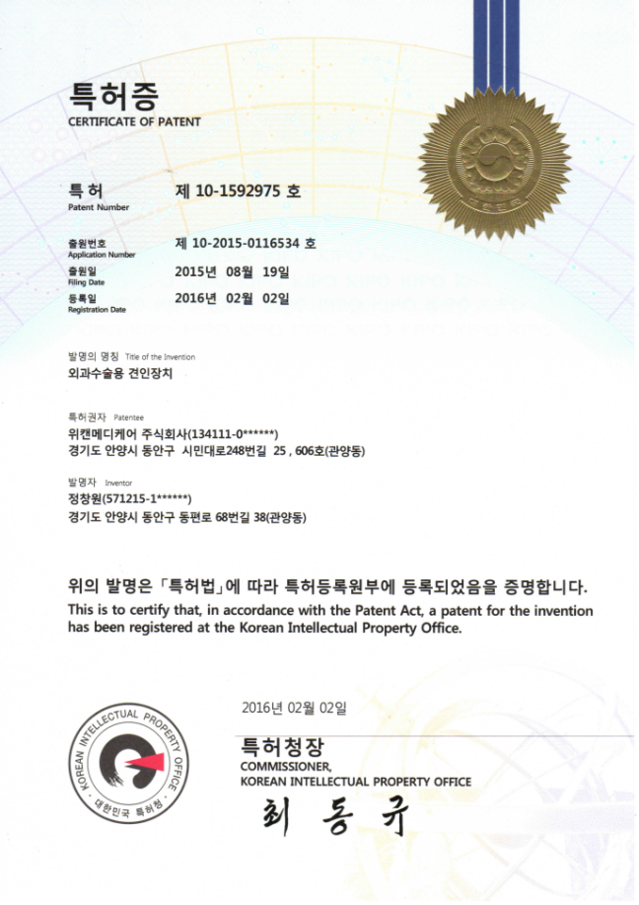
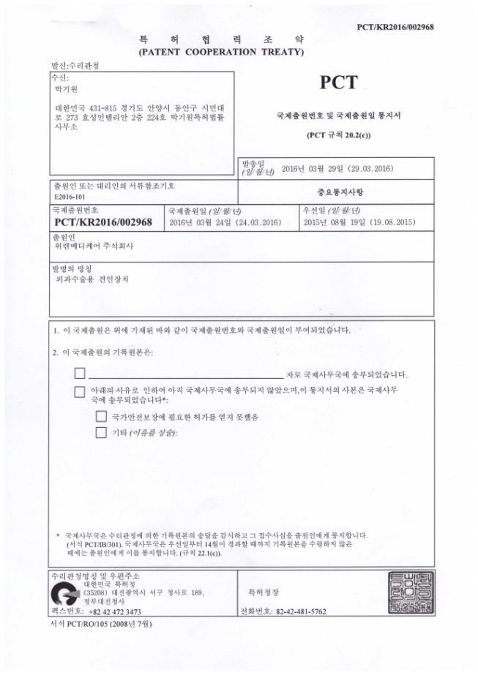
Patent/Approvals
Patent
Patent was approved on Feb. 2, 2016
PCT(PCT/KR2016/002968) submitted on Mar. 24, 2016
Defense patents submitted to prevent imitation

Slide 28
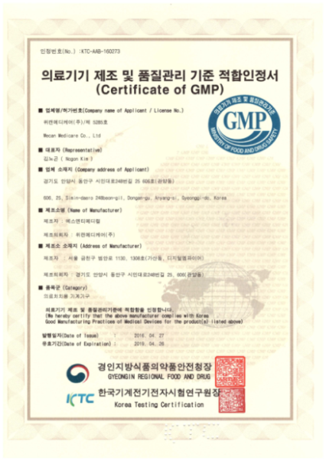
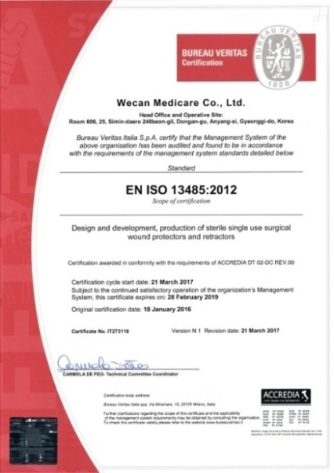
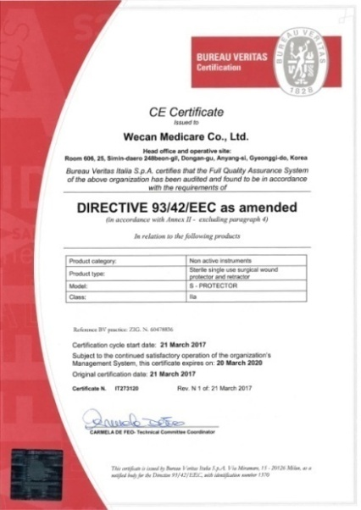
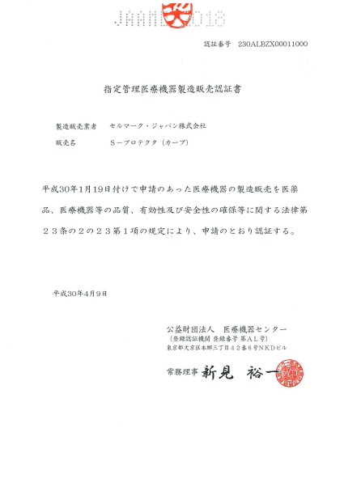
Patent/Approvals
Approvals
KGMP approved on Apr. 27, 2016
ISO 13485 approved on Jan. 18, 2016
CE certified on Mar. 21, 2017
US FDA registered on July 31, 2017
Japan JAAME approved on Apr. 9, 2018

Slide 29
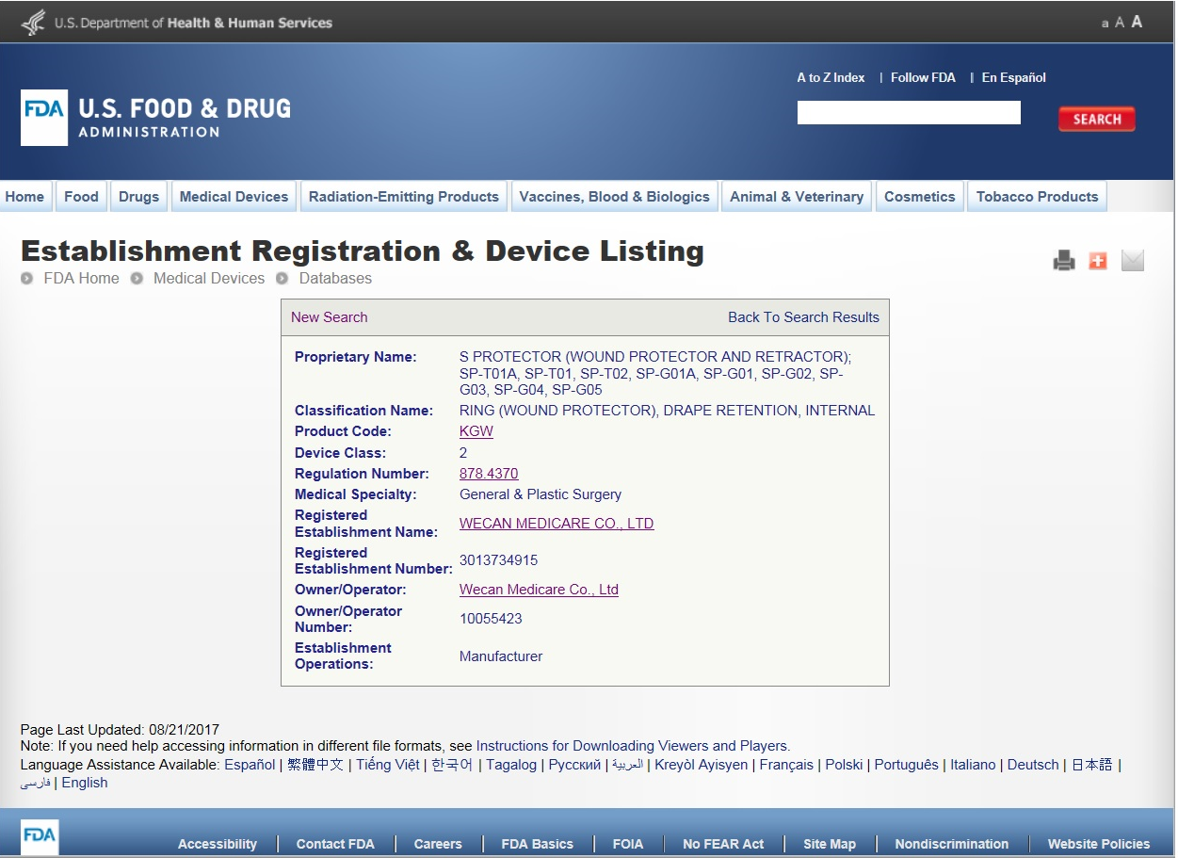
Patent/Approvals
FDA registration of S-protector
Regulation Number: 878. 4370
Registered Establishment Number: 3013734015

Slide 30
Content
1. Introduction of S-protector
2. Patent/Approvals
3. Marketing activities

Slide 31
Marketing activities
How to develop new values
Value to be developed | How to
Reduce post-surgery pain, scarring, risk of Contamination and stray burns | Clinical trials
Save surgical preparation, surgical assistants | Hospital survey
Unexplored market | Seminar, education, Tradeshow/exhibition

Slide 32
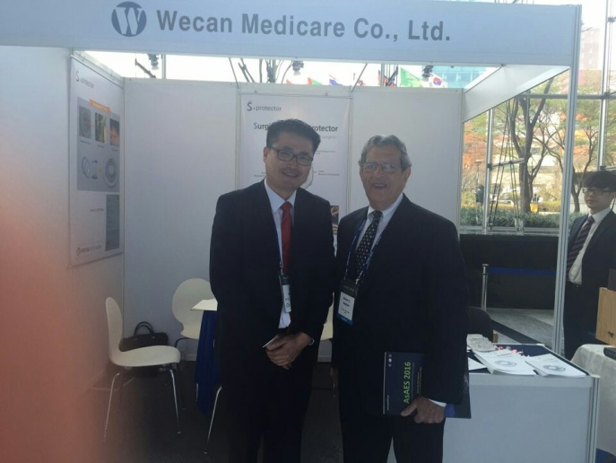
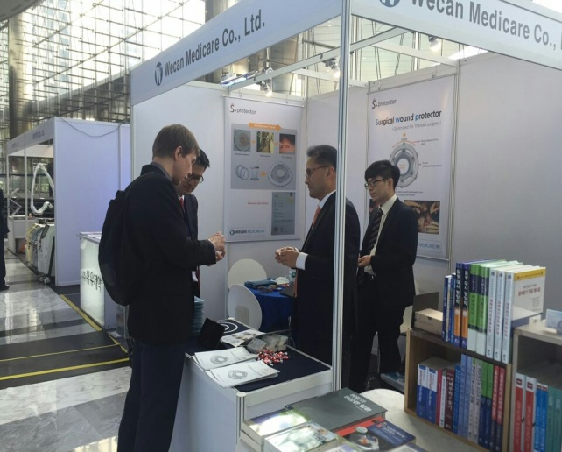
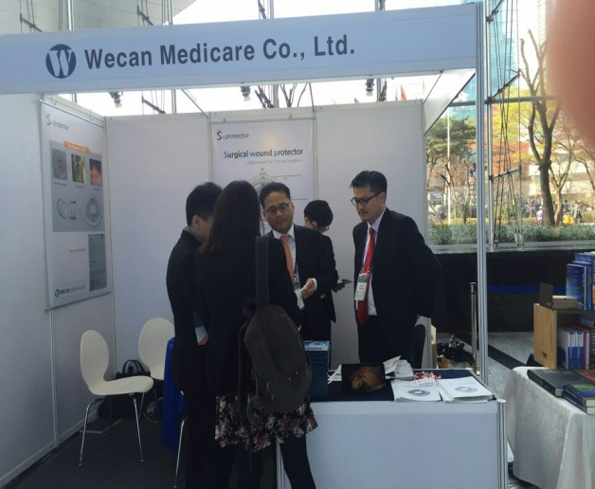
Marketing activities
AsAES (Apr., 2016)
- 15th Asian Association of Endocrine Surgeons held in COEX, Seoul, Korea
- 600 surgeons from 26 countries attended/visited the seminar
- Dr. Edwin Kaplan(A past president of American Association of Endocrine Surgeons)
visited our booth and highly appreciated S-protector
- Introduced S-protector to University of Hong Kong and 37 other hospitals

Slide 33
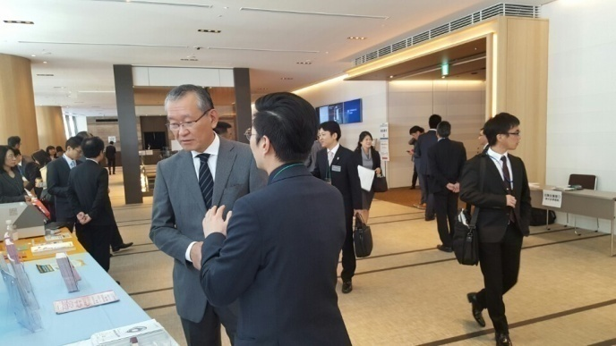
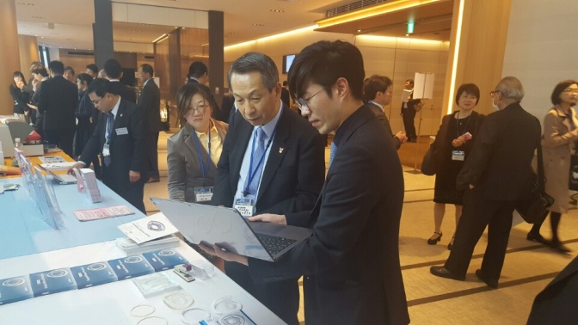




Marketing activities
JTA (Nov., 2016)
- 59th Japan Thyroid Association(Nov. 3 ~ 5) held in Tokyo, Japan
- As a result, the usability test started at Ito hospital which is the largest hospital in
Thyroid surgery in Japan(Dr. Wataru Kitagawa)
- Introduced to Noguchi Hospital, Higashi Nagoya National Hospital and others

Slide 34



Marketing activities
Approved by Ito hospital in Japan
S-protector was approved by Ito hospital which is the most renowned in Thyroid surgery and related medical treatments in Japan.
The quality evaluation test was conducted by
MD. Wataru Kitagawa /Chief of Department of Medical Technology & Surgery, Ito hospital in 2017.

Slide 35






Marketing activities
AAES (Apr., 2017)
- 38th AAES(American Association of Endocrine Surgeons, April 2 ~ 4, 2017) held
at Rosen Centre Hotel in Orlando, FL, USA
- Introduced to University of Boston, London Bridge Hospital, Brown University,
Mayo Clinic, University of California and 27 other hospitals

Slide 36






Marketing activities
WCS (Aug., 2017)
- 47th WCS(World Congress of Surgery of the international Society of Surgery(ISS),
Aug. 13~17) held in Basel, Switzerland
- Introduced to John Hunter Hospital, Genolier clinique, National Taiwan University
Hospital, Parklands Medical Centre and other hospitals

Slide 37









Marketing activities
MEDICA (Nov., 2017)
- MEDICA(Nov. 13 ~ 16) held in Dusseldorf, Germany
- 5,094 exhibitors, 123,500 visitors from 130 countries participated in
- 40 companies from 23 countries visited our booth and had biz meetings

Slide 38
Global Best Protector in 2020
Thank you !!!

