Slide 1
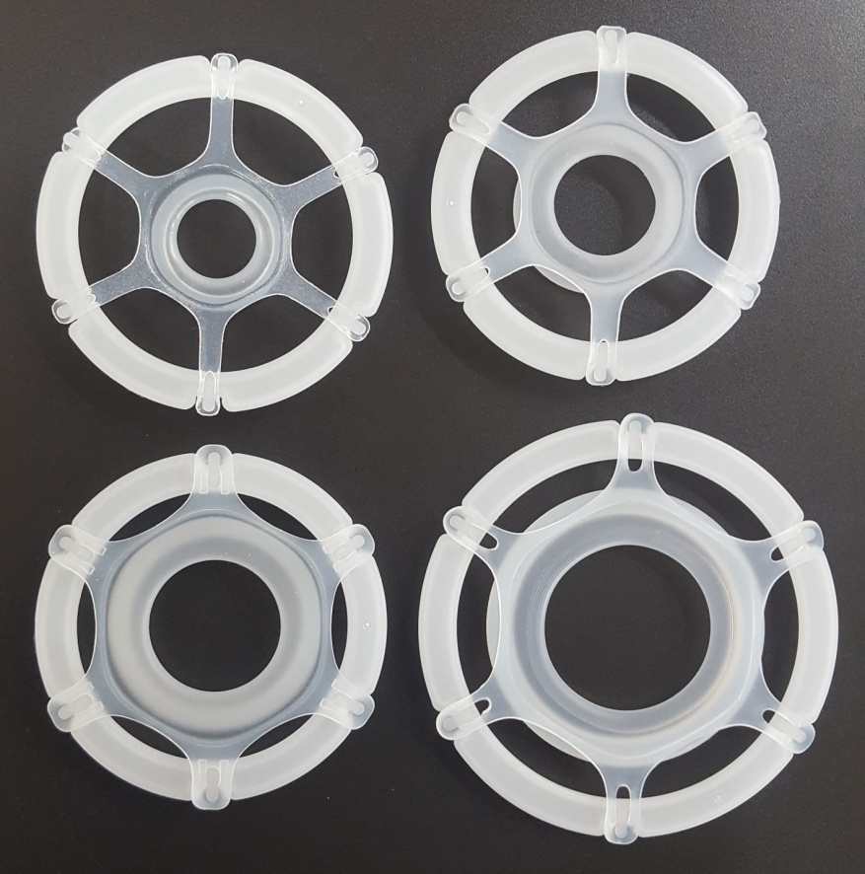
S-protector for General surgery
SP-G01C
SP-G01B
Model | Code | Incision size
SP-G01C | XXS | 1 ~ 2 cm
SP-G01B | XS | 2 ~ 3 cm
SP-G01A | S | 3 ~ 5 cm
SP-G01 | M | 5 ~ 7 cm
SP-G01A
SP-G01

Slide 2
Procedural Applications
 | Procedural Applications | Product code
General | Inguinal Hernia Repair | XS, S
 | Thyroidectomy | XXS, XS, S, M
 | Appendictomy | S, M
Breast | Lumpectomy | XS, S
 | Mastectomy | S, M
 | Sentinel Lymph Node Biopsy | XXS, XS, S
OB/GYN | Postpartum Tubal Ligation | XXS, XS
 | Bilateral Salpingo Oophorectomy | XS, S
 | Myomectomy | S, M
Colon & Rectal | Stoma Formation | XXS
Cardiothoracic | Video Assisted Thoracoscopic Surgery | XXS, XS, S
 | Mitral Valve Repair | S, M
 | Thoracotomy | S, M
Orthopaedic | Total Shoulder Arthroplasty | S
 | Total Hip Arthroplasty | S, M

