Slide 1
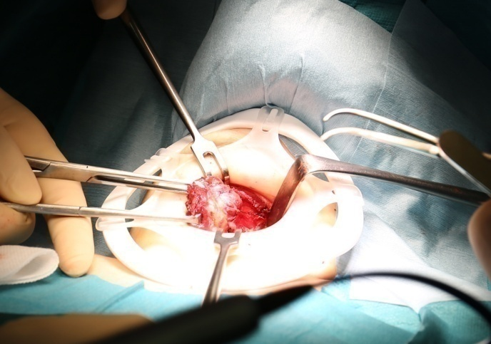
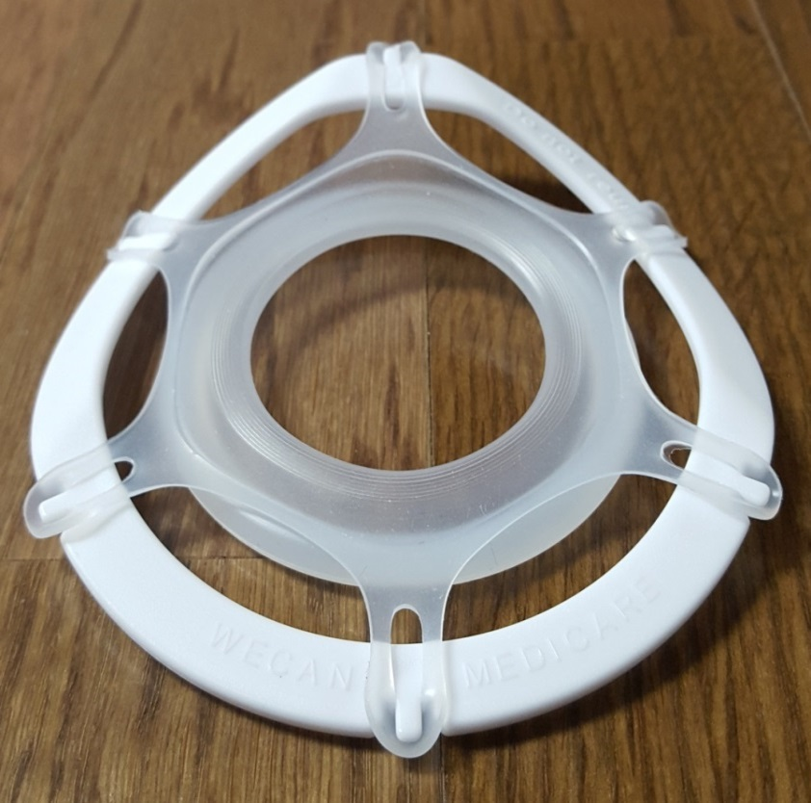
S-protector
(Surgical wound protector for thyroidectomy)
Head side
Curved shape to fit to the neck
Code | Incision size
XX-small* | 1 ~ 2 cm
X-small | 2 ~ 3 cm
Small | 3 ~ 5 cm
Medium | 5 ~ 7 cm
Large* | 7 ~ 10 cm
Protector
(Material: Silicon)
Protect the skin edge and retract
the surgical cavity
Frame
(Material: Polypropylene)
*XX-small size will be commercialized
in April 2018

Slide 2
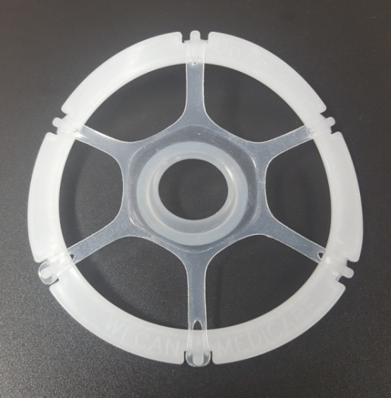
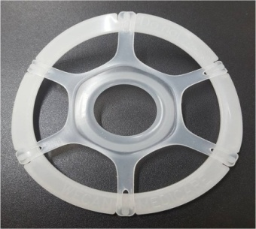
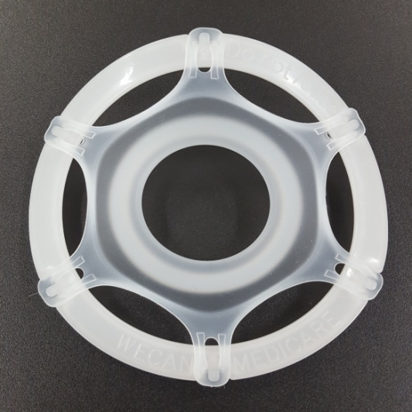
S-Protector for thyroid surgery
 | SP-T01C
Code | XXS
Incision | 1~2 cm
 | SP-T01B
Code | XS
Incision | 2~3 cm
 | SP-T01A
Code | S
Incision | 3~5 cm

Slide 3
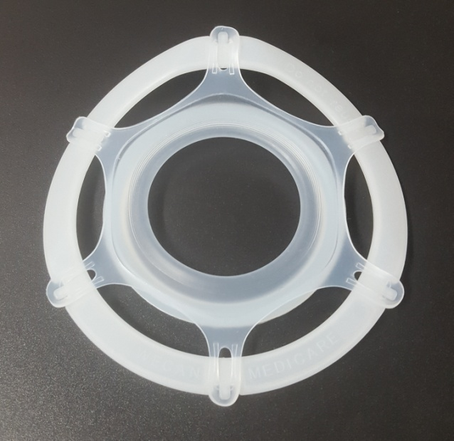
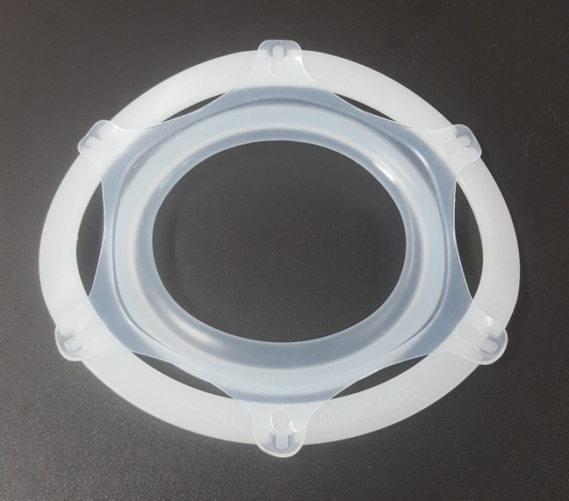
S-Protector for thyroid surgery
 | SP-T01
Code | M
Incision | 5~7 cm
 | SP-T02
Code | L
Incision | 7~10 cm

Slide 4

Model SP-T01(M) used for Thyroid surgery
The picture was provided by Wataru Kitagawa MD. Ph. D/Chief of Department of Medical Technology & Surgery of Ito Hospital, Tokyo, Japan

Slide 5

